Slide 1
D.STEFFY
CHARACTER AND DIGIT RECOGNITION
3/21/2024 Annual Review

Slide 2
CHARACTER AND DIGIT RECOGNITION
Character and digit recognition technology involves the identification and interpretation of written characters and numerical digits. This field has wide-ranging applications in areas such as document scanning, automation, and digital security.
3/21/2024 Annual Review

Slide 3


AGENDA
Introduction:
Overview of character and digit recognition.
Challenges:
Key issues faced in recognition technology.
Solutions:
Proposed approaches and value proposition.
3/21/2024 Annual Review

Slide 4

PROBLEM STATEMENT
Complexity
Variability in handwriting and font styles.
Data Quality
Issues with noisy and poor-quality images.
Speed
Real-time recognition requirements.
3/21/2024 Annual Review

Slide 5

PROJECT OVERVIEW
Research
Exploration of existing recognition models.
Analysis of data sets and feature extraction.
Development
Implementation of machine learning algorithms.
Optimization of recognition accuracy.
Testing
Evaluation of performance and error analysis.
Integration with target applications.
3/21/2024 Annual Review

Slide 6

WHO ARE THE END USERS?
Businesses:
Automated data entry and form processing.
Financial Institutions:
Check scanning and document verification
Government Agencies:
Identity verification and security applications.
3/21/2024 Annual Review

Slide 7

YOUR SOLUTION AND ITS VALUE PROPOSITION
Accuracy
High precision in recognizing characters and digits.
Efficiency
Fast and reliable processing of digital content.
Adaptability
Ability to handle multiple writing styles and fonts.
3/21/2024 Annual Review

Slide 8

THE WOW IN YOUR SOLUTION
Innovation
State-of-the-art recognition algorithms.
Efficiency
Rapid processing speed with minimal errors.
Versatility
Adaptability to diverse input sources
3/21/2024 Annual Review
8

Slide 9
MODELLING
Deep Learning | Neural network-based feature extraction.
Statistical Analysis | Probability distribution for character predictions.
Pattern Recognition | Identification of complex handwritten patterns.
3/21/2024 Annual Review
9

Slide 10

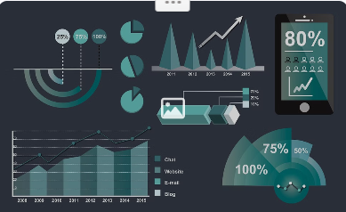
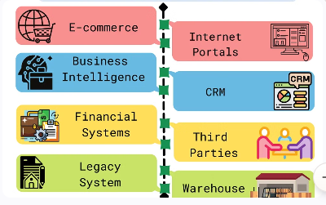
RESULTS
Recognition Accuracy
Consistently high accuracy rates achieved.
Performance Analysis
Granular assessment of recognition performance.
Application Integration
Seamless implementation into diverse software systems.
Demo Link
3/21/2024 Annual Review
10

